Slide 1

IMDB MOVIE ANALYSIS
SWAGATIKA SAMAL

Slide 2

Agenda
Introduction
Tech Stack Used
DataSet Used
Questionnaire
Approach
Conclusion

Slide 3

Introduction
The dataset focuses on IMDB Movies, and a compelling question to explore is: "Which factors contribute to a movie's success on IMDB, specifically in terms of achieving high ratings?" The implications of investigating this question are substantial for stakeholders in the film industry, including producers, directors, and investors. By delving into the determinants of a movie's success, these industry professionals can gain valuable insights to make informed decisions in planning and executing future projects.
In this exploration, the goal is to analyze the data to uncover relationships between various variables. This involves examining the correlation between movie ratings and factors such as genre, director, budget, and others. Additionally, considerations will be given to the year of release, the actors involved, and other pertinent elements.

Slide 4
Introduction
Applying the Five 'Whys' Approach allows for a deeper understanding of the problem. For instance, if a pattern emerges indicating that movies with higher budgets tend to receive higher ratings, probing with "Why?" multiple times can reveal the underlying causes:
Movies with higher budgets tend to have higher ratings because they can afford better production quality.
Better production quality, in turn, leads to higher ratings.
An enhanced viewer experience is a result of better production quality.
Viewers are more likely to rate a movie highly if they enjoyed watching it.
Positive experiences, reflected in positive reviews, influence other viewers' decisions to watch the movie, subsequently increasing its popularity and success.

Slide 5
TECH STACK USED
I have used
Microsoft Excel to solve the questionnaire
Microsoft Power Point to prepare the presentation

Slide 6

QUESTIONNAIRE & APPROACH
Let’s dive in

Slide 7

Data Cleaning
Blanks and unwanted rows were cleaned.
Columns were reduced .
After removing null values, the rows were reduced to 4901.

Slide 8
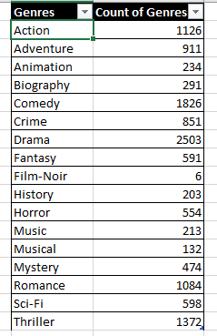
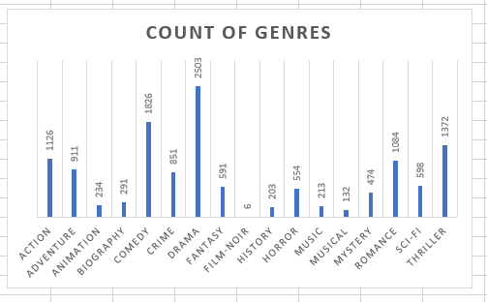
Goals for Q1A
Distribution of Movie Genres
Representation as a graph
To identify the most prevalent genres in the dataset, the solution involves utilizing Excel's COUNTIF function. This entails counting the occurrences of each genre in the 'genres' column. Additionally, it may be necessary to manipulate the 'genres' column to handle instances where multiple genres are associated with a single movie. By employing this approach, a comprehensive understanding of the distribution of movie genres within the dataset can be obtained.

Slide 9

Goals for Q1B
Impact of genres on IMDB_Score
Solution
Manipulating the 'genres' column required to handle instances where multiple genres are associated with a single movie. Utilizing Excel's functions, including AVERAGE, MEDIAN, MODE, MAX, MIN, VAR, and STDEV, to calculate descriptive statistics. By comparing these statistics, a comprehensive understanding of the impact of genre on movie ratings is gained.

Slide 10

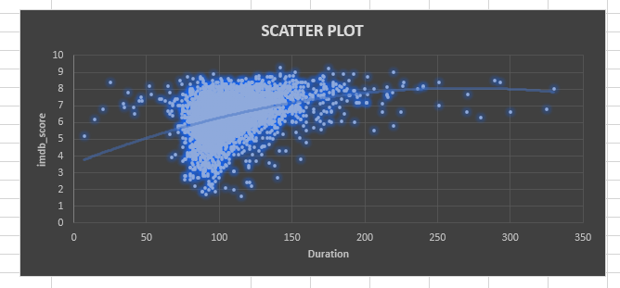
Goals for Q2
Distribution of movie duration & its impact on IMDB_Score
Solution
Examining the distribution of movie durations and ascertain the correlation between movie duration and IMDB score. I have employed Excel's functions, including AVERAGE, MEDIAN, and STDEV, to compute descriptive statistics such as mean, median, and standard deviation for movie durations. Then created a scatter plot for a visual representation of the relationship between movie duration and IMDB score, and enhanced the analysis by adding a trendline to evaluate the direction and strength of the observed relationship.

Slide 11
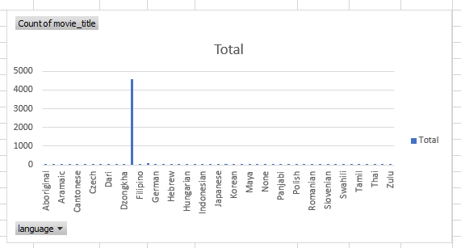
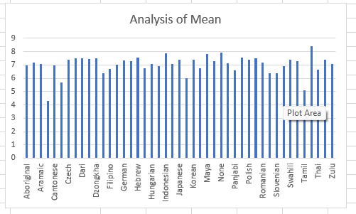
Goals for Q3
Representation as a graph
Distribution of movies based on
their languages
Identified the predominant languages featured in movies and conducted an analysis of their influence on the IMDB score through the application of descriptive statistics. Used pivot table to enumerate the quantity of movies associated with each language. Calculated the mean of the IMDB scores for each language, and subsequently compare these statistics to gain insights into the impact of language on movie ratings.

Slide 12
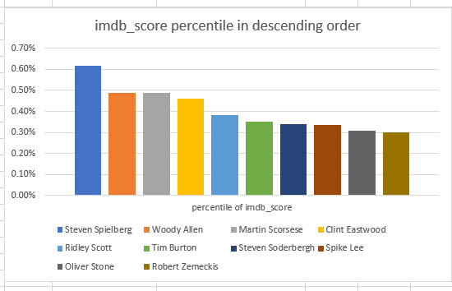
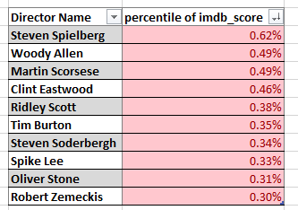
Goals for Q4
Influence of directors on movie
Ratings
Representation as a graph
Determined the leading directors by assessing their average IMDB scores and explored their impact on the success of movies through percentile calculations. Calculated the average IMDB score for each director and employ Excel's PERCENTILE function to pinpoint directors with the highest scores.

Slide 13
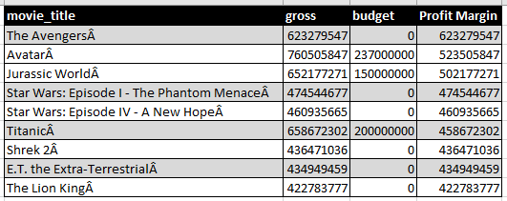
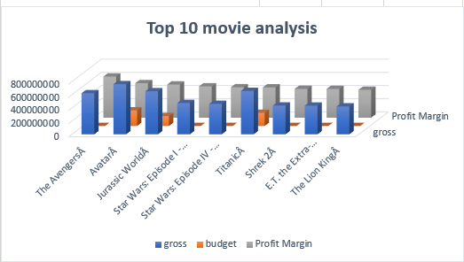
Goals for Q5
Representation as a graph
Identifying movies with highest profit margin
Computed the profit margin for each movie by subtracting the budget from gross earnings, and then identified the movies with the highest profit margin.

Slide 14

Engaging in this project enlightened me about the significance of Data Analytics in the movie analysis, offering crucial insights like top rated movies based on genre, language, director and earnings. These insights empower IMDB website as highest grossing website for exploring the kinds of movie to watch.

